Slide 1

RISC; CISC
Computer Organization and Architecture | Register Organization
Computer Organization and Architecture | Register Organization | Bachelor of Engineering
DISCOVER · LEARN · EMPOWER
Notes:
Welcome everyone to today's lecture on Register Organization. We will specifically focus on the two dominant instruction set architectures: RISC and CISC. Understanding these is crucial for analyzing how registers are utilized in modern processors. Let us begin our journey into the heart of computer architecture.

Slide 2
Course Outcomes
SLIDE 2 / 10
Course Outcome
CO | BT LEVEL | DESCRIPTION
CO1 | BT3 | Apply number systems and digital logic to design basic digital circuits
CO2 | BT4 | Analyze register organization and instruction set architecture
CO3 | BT3 | Implement computer arithmetic algorithms and floating-point operations
CO4 | BT5 | Analyze memory hierarchy and input-output organization
CO5 | BT6 | Evaluate control unit design and pipelining performance
Chandigarh University
2 / 10
Notes:
Today's lecture directly addresses Course Outcome 2. You will learn to analyze how different instruction sets dictate the usage of registers. This analysis is fundamental to understanding processor performance and design trade-offs. By the end, you will be able to compare RISC and CISC register strategies effectively.

Slide 3
Learning Objectives
SLIDE 3 / 10
Learning Outcomes
1
Differentiate between RISC and CISC instruction set philosophies.
2
Analyze the role of registers in RISC versus CISC designs.
3
Evaluate the impact of instruction length on register usage.
4
Compare execution speed and hardware complexity of both architectures.
Chandigarh University
3 / 10
Notes:
By the end of this session, you will be able to differentiate the core philosophies of RISC and CISC. We will analyze how each architecture treats registers as either memory operands or internal storage. You will also evaluate how instruction length directly influences the number of registers required for efficient execution.

Slide 4
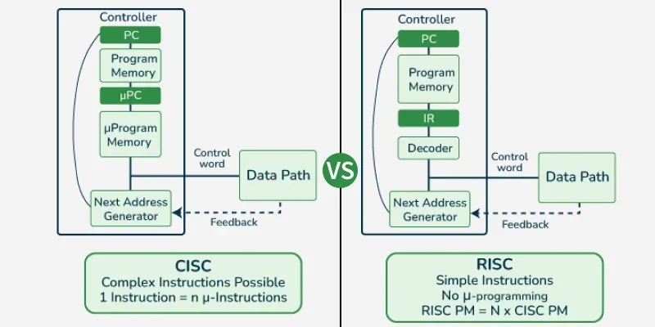
Lecture
SLIDE 4 / 10
CISC Philosophy and Registers
EXAMPLE
A single CISC instruction can load, add, and store data.
• CISC uses complex instructions that can perform multiple operations in one cycle.
• Instructions often operate directly on memory, reducing the need for many registers.
• Variable-length instructions allow compact code but complicate register decoding.
• Register usage is optimized for code density rather than execution speed.
RISC vs CISC - GeeksforGeeks
Chandigarh University
4 / 10
Notes:
CISC stands for Complex Instruction Set Computer, focusing on reducing the number of instructions per program. In this architecture, instructions are complex and can access memory directly, which reduces the reliance on a large register file. For example, a single instruction might load a value, add it to another, and store the result back to memory without explicit register moves.

Slide 5
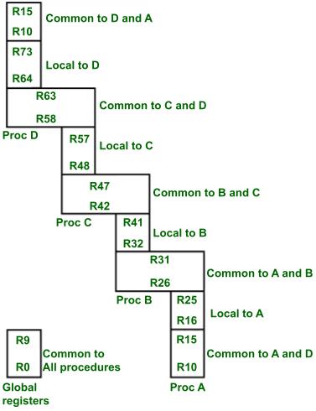
Lecture
SLIDE 5 / 10
RISC Philosophy and Registers
EXAMPLE
Load R1, Memory; Add R1, R2; Store R1, Memory.
• RISC uses simple instructions that execute in a single clock cycle.
• All arithmetic operations must occur between registers, not memory.
• Fixed-length instructions simplify decoding and allow deep pipeline stages.
• Requires a large number of general-purpose registers to hold data.
Register Organization in RISC CPU - GeeksforGeeks (source: media.geeksforgeeks.org)
Chandigarh University
5 / 10
Notes:
RISC stands for Reduced Instruction Set Computer, emphasizing simplicity and speed. In RISC, every arithmetic operation must happen between registers, meaning memory access is restricted to load and store instructions only. This design necessitates a large register file to minimize memory accesses, as seen in the example where data moves explicitly between registers.

Slide 6
Lecture
SLIDE 6 / 10
Register Usage Comparison
1
CISC typically uses fewer registers due to memory-to-memory operations.
2
RISC requires more registers to support register-to-register operations.
3
CISC instructions are longer, often encoding memory addresses directly.
4
RISC instructions are fixed-length, leaving more bits for register specifiers.
5
High register count in RISC reduces memory latency significantly.
Register Organization in RISC CPU - GeeksforGeeks (source: media.geeksforgeeks.org)
Chandigarh University
6 / 10
Notes:
The fundamental difference lies in how registers are utilized. CISC architectures often get by with fewer registers because they can operate directly on memory operands. In contrast, RISC architectures require a larger set of registers to keep data close to the processor, avoiding the latency of frequent memory accesses. This trade-off defines the hardware complexity of each design.

Slide 7
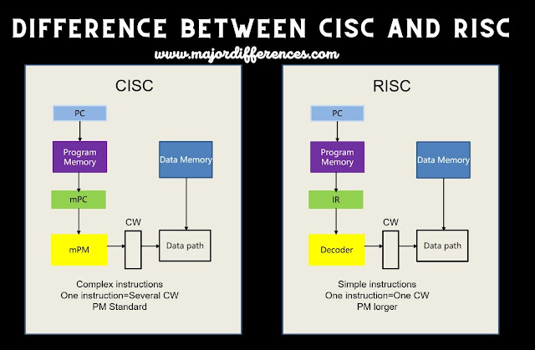
Lecture
SLIDE 7 / 10
Instruction Length and Decoding
1
CISC uses variable-length instructions ranging from 1 to 15 bytes.
2
RISC uses fixed-length instructions, typically 32 bits or 16 bits.
3
Variable length in CISC complicates the instruction fetch and decode stages.
4
Fixed length in RISC allows for parallel instruction fetching and decoding.
5
Simplified decoding in RISC leads to faster clock cycle ×.
Difference between CISC and RISC | CISC vs RISC (source: blogger.googleusercontent.com)
Chandigarh University
7 / 10
Notes:
Instruction length plays a critical role in register organization and decoding. CISC uses variable-length instructions, which makes the hardware complex because the processor must determine where each instruction ends. RISC uses fixed-length instructions, allowing the hardware to fetch and decode multiple instructions simultaneously, which significantly boosts the clock speed.

Slide 8
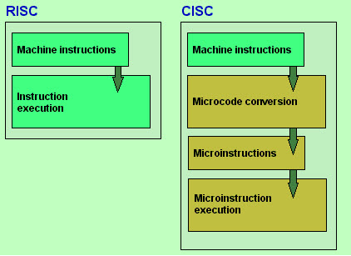
Lecture
SLIDE 8 / 10
Performance and Complexity Trade-off
1
CISC reduces code size but increases hardware complexity and decoding time.
2
RISC increases code size but simplifies hardware and improves speed.
3
CISC relies on microcode to handle complex instructions internally.
4
RISC relies on compilers to generate efficient sequences of simple instructions.
5
Modern processors often blend features of both architectures.
RISC and CISC Architecture - Working & Their Applications (source: www.watelectronics.com)
Chandigarh University
8 / 10
Notes:
There is a clear trade-off between code density and execution speed. CISC reduces the size of the program but requires complex hardware to decode and execute instructions. RISC increases the program size but simplifies the hardware, allowing for faster execution. Modern processors often blend these features, using RISC-like pipelines with some CISC-like instruction decoding.

Slide 9
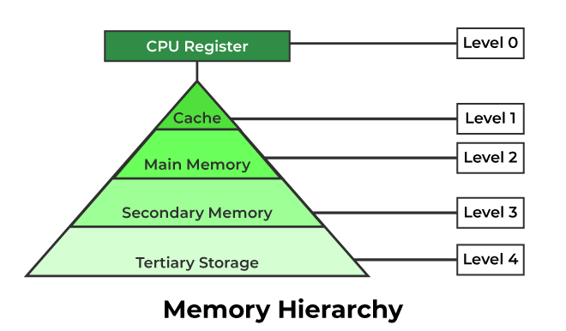
Lecture
SLIDE 9 / 10
Key Takeaways
1
CISC uses complex, variable-length instructions with memory operands.
2
RISC uses simple, fixed-length instructions with register-only operations.
3
RISC requires more registers to minimize memory access latency.
4
CISC reduces code size while RISC maximizes execution speed.
5
Register organization is the primary differentiator between the two.
Source: media.geeksforgeeks.org
Chandigarh University
9 / 10
Notes:
To summarize, CISC focuses on complex instructions and memory operations, while RISC focuses on simplicity and register usage. The key takeaway is that RISC requires a larger register file to achieve high performance through pipelining. Understanding these differences is essential for analyzing modern processor designs and their register organization strategies.

Slide 10
Lecture
SLIDE 10 / 10
References
COMPUTER ORGANIZATION AND DESIGN
The Hardware/Software Interface — David A. Patterson, John L. Hennessy
COMPUTER ARCHITECTURE
A Quantitative Approach — John L. Hennessy, David A. Patterson
• Computer Organization and Architecture — William Stallings
• Computer System Architecture — M. Morris Mano & Rajib Mall
• Computer Organization — Carl Hamacher, Zvonko Vranesic, Safwat Zaky
Chandigarh University
10 / 10
Notes:
These references provide the foundational knowledge for the concepts discussed today. I encourage you to read the chapters on instruction sets in Stallings and Patterson for deeper insights. These texts offer detailed comparisons and real-world examples of RISC and CISC implementations. Thank you for your attention, and please review these materials for your upcoming assignments.

